Slide 1
Smart Player API /Media API
TechTime for Sales
Date: May 30, 2013
Presented by: Robert Crooks

Slide 2
Welcome
“TechTime for Sales” is a sales training initiative with a goal to provide the BC sales organization with the technical information needed to help drive new, upgrade, renewal and add-on sales.
Please provide your inputs on this session and ideas for future topics of interest to Roberta Ingham
The slides and a recording of this session will be available within 1 week on Sales Central under Sales Training in a document called TechTime for Sales date topic

Slide 3
Agenda

Slide 4
Video Cloud from the perspective of Business Users and Developers

Slide 5
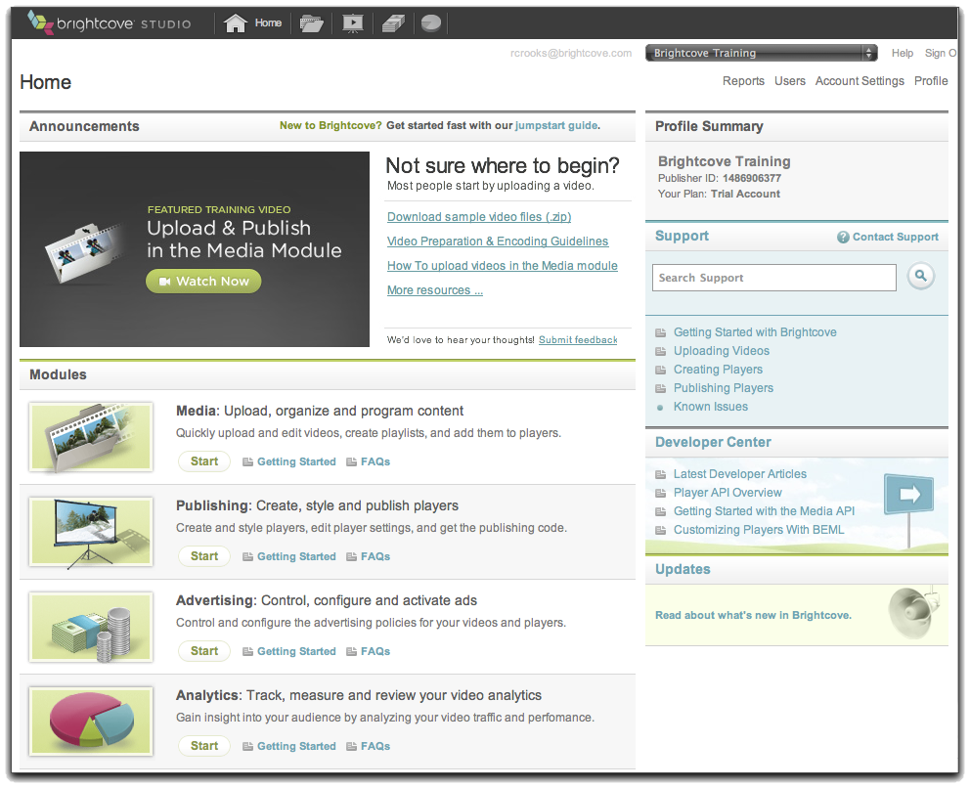
Video Cloud – Business User Perspective
Publishing code
(Publisher, Player
Video IDs, Player
Dimensions)
Transfer videos
Your Web Server
Content Delivery Network
(CDN)
Video Cloud Servers
Transcode and
store videos with
metadata, playlists,
player settings
Requested page
with references
to player and
videos
Upload video,
add settings
Viewer
Your System
Video Cloud Studio

Slide 6
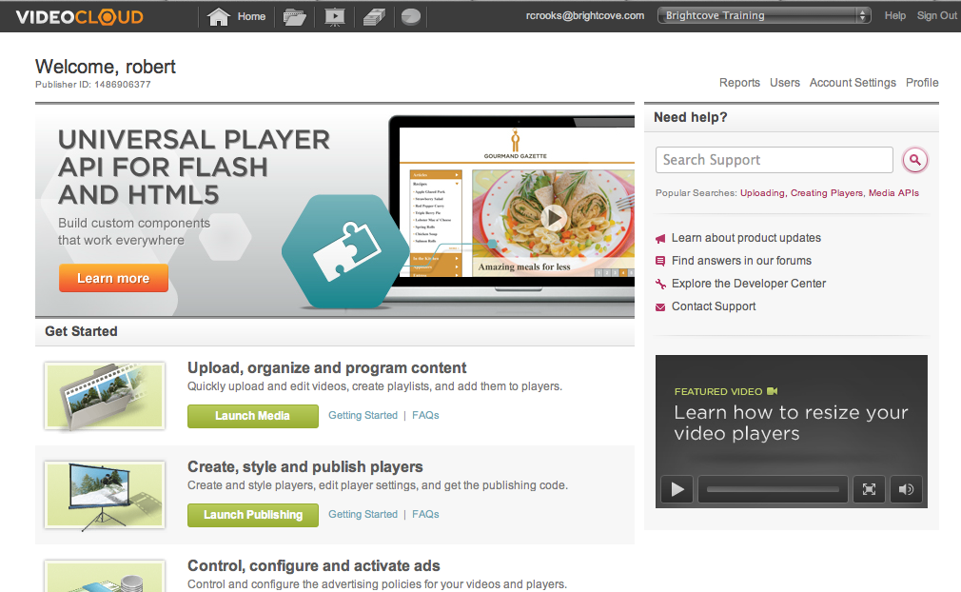
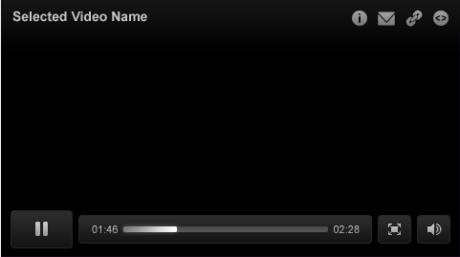
Video Cloud – Developer Perspective
Transcoding Service
System
User-Initiated
Video Cloud
Media Repository
BEML
CDN
Media API
Batch Provisioning
Aspera
Smart Player API
My Site
My Media
Player
Flash-Only Player API

Slide 7
Introduction to the Smart Player API
A JavaScript API – requires JavaScript programming

Slide 8
What it does and doesn't do
It does…
Allow you to manipulate the video player in the browser
Allow you to create content in the page that interacts with the player
Work for both Flash and HTML5 players
Allow you to set ad policies dynamically
Retrieve videos or playlists from the Video Cloud server
Load videos into the player
Act in response to cue points or video progress
Update video properties for a video in the player
It does not…
Modify videos in your account or account settings in any way
Allow you to modify the player itself, except for overall resizing

Slide 9
Typical Use Cases
Chaptered video
Call-to-action
Video Portals / "Playlists" in the page, not the player
Lightbox players
Player overlays
Responsive players

Slide 10
Introduction to the Media API
A REST-based API – requires programming in any language (Java, .NET, PHP, Ruby, etc.) – can be used on the client or server side

Slide 11
What it does and doesn't do
It does…
Allow you to search for videos by many criteria
Allow you to create, update, delete videos (good tool for UGC, not volume uploads)
Allow you to share and un-share videos
Allow you to create RSS/MRSS video feeds
Allow you add/remove captions from videos
Allow you to get the status of an uploaded video (is it playable?)
It does not…
Interact with players in any way

Slide 12
Typical Use Cases
Contextual publishing – publish any video metadata with the video or find videos related to content)
Custom Related Videos
Video Portals / "Playlists" in the page, not the player (used with the Smart Player API)
SEO (by embedding video metadata in the the page and/or creating video sitemaps)
Create simplified “mini studios” or apps that expose just the functionality that users need
Integration with CMS

Slide 13
Brightcove vs. the competition

Slide 14
Brightcove vs. the rest
There is no real technical advantage – our competitors have good APIs also
Where we have a clear advantage is in documentation and sample applications/code
http://docs.brightcove.com/en/index.html

